Slide 1
Data Structures and Algorithms Lecture 6
Insertion Sort And Merge Sort
Department of Computer Science & Technology
United International College

Slide 2
Outline
Motivation
Insertion Sort
Merge Sort
Divide and Conquer

Slide 3
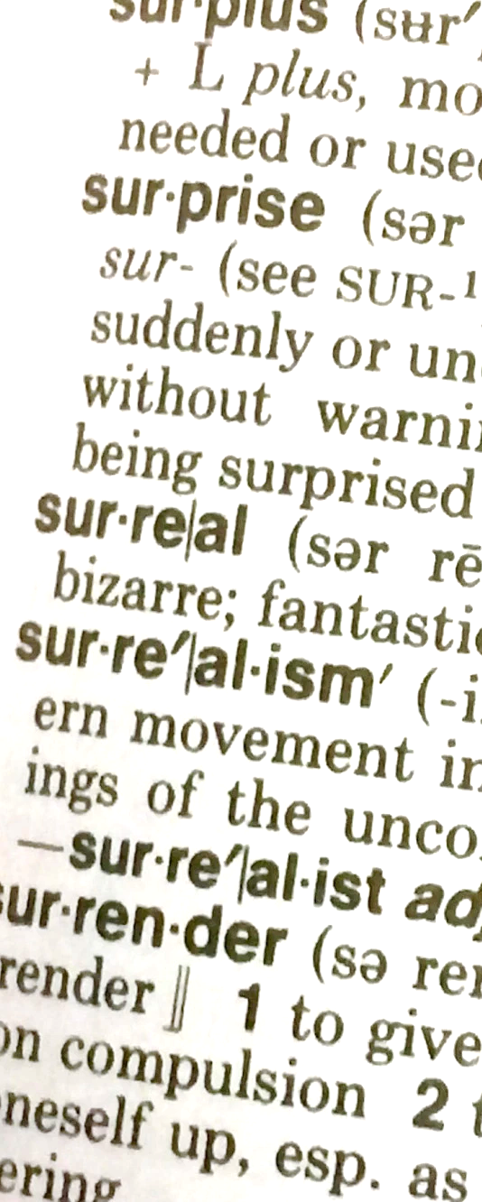
Sort them beforehand!
Motivation
How do you quickly find
Your name in a name list?
A book on a shelf?
A word in a dictionary?

Slide 4
Insertion Sort
“Let the first p items be sorted.”

Slide 5
Insertion Sort
1) Initially p = 1
2) Let the first p elements be sorted.
3) Insert the (p+1)th element properly in the list so that now p+1 elements are sorted.
4) increment p and go to step (3)

Slide 6
How is Insertion Done?
3) Insert the (p+1)th element properly in the list…
Scan leftwards
Move every greater element one position to the right
Thus making room for the new element
Stop when
a smaller or equal element is found
the left boundary is reached
Move the new element in
Animation

Slide 7
Pseudo Code for Insertion Sort
INSERTION-SORT(A) 1. FOR p = 1 TO n-1 2. key = A[p] 3. i = p – 1 4. WHILE i >= 0 AND A[i] > key 5. A[i+1] = A[i] 6. i = i – 1 7. A[i+1] = key

Slide 8
Discussion
What is the best case for insertion sort?
Best case running time?
What is the worst case for insertion sort?
Worst case running time?
What is the average running time?
Assume that all possible inputs are of the same probability.

Slide 9
Analysis of Insertion Sort
Best-case Running Time | O(n)
Worst-case Running Time | O(n²)
Average Running Time | O(n²)
Insertion Sort's exact running time cannot be predicted in advance
The running time largely depends on the input
It is considered an O(n²) algorithm, based on its average running time.

Slide 10
Merge Sort
A divide-and-conquer (DC) algorithm

Slide 11
Merge Sort
Divide the list into two smaller lists of about equal sizes
Sort each smaller list recursively
Merge the two sorted lists to get one sorted list
Animation

Slide 12
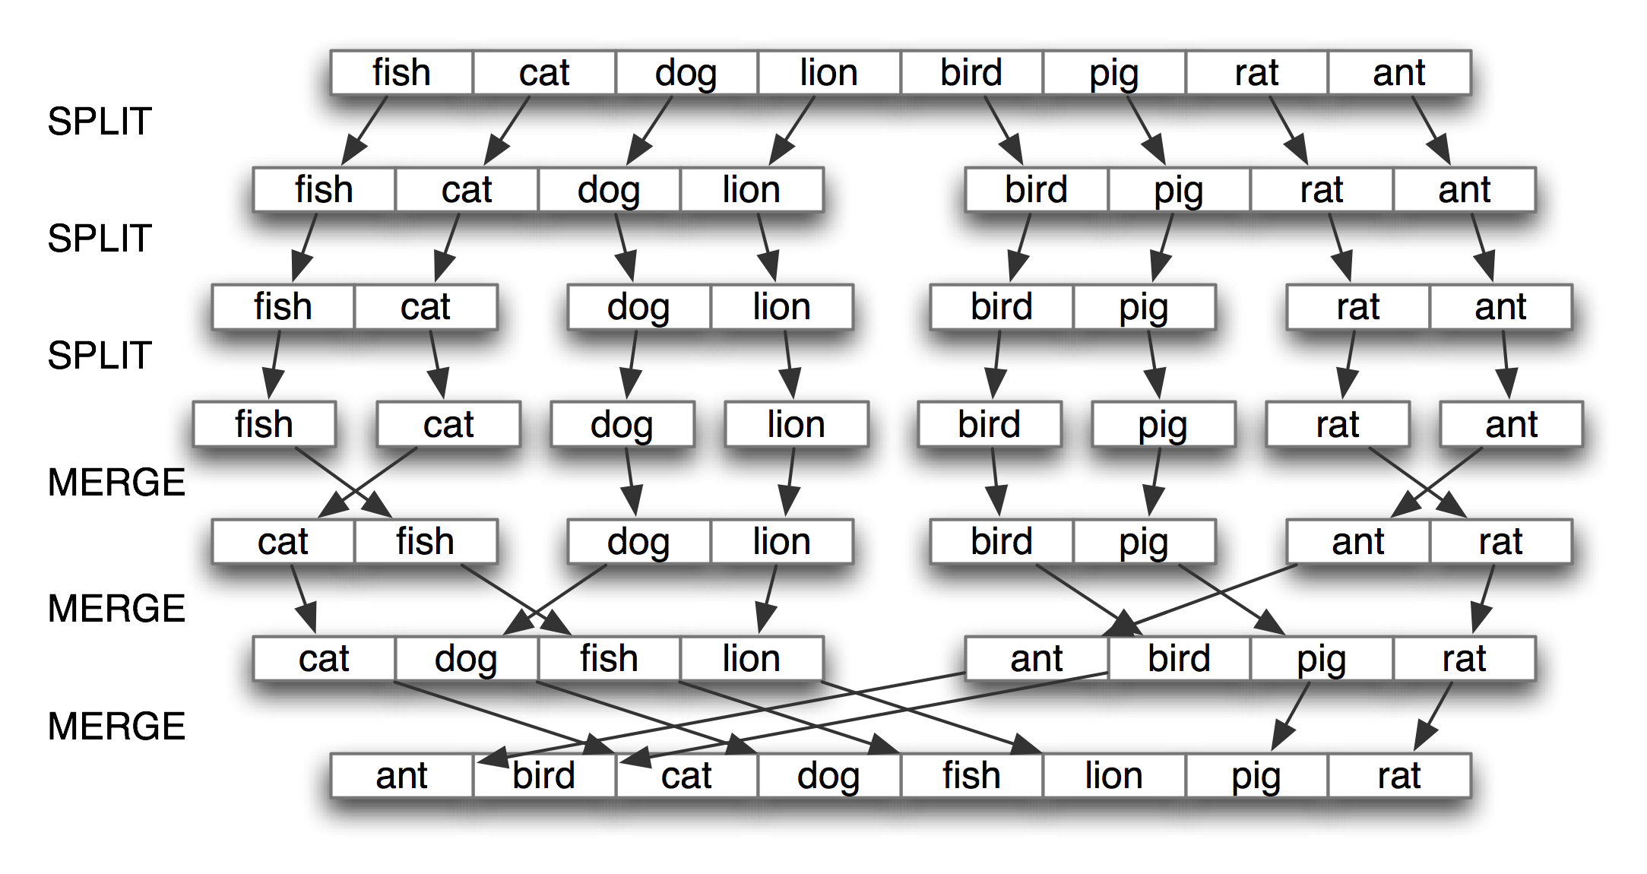
Merge Sort Example

Slide 13
Questions to Ponder
How do we divide the list?
How much time is needed?
How do we merge the two sorted lists?
How much time is needed?

Slide 14
Dividing
If the input list is a linked list, dividing takes Θ(N) time
We scan the linked list, stop at the ⎣N/2⎦ th entry and cut the link
If the input list is an array A[0..N-1]: dividing takes O(1) time
represent a sublist by two indexes left and right
to divide A[left..right], we compute center=(left+right)/2 and obtain A[left..center] and A[center+1..right]
Array is usually used as the data structure for sorting

Slide 15
Mergesort
MERGESORT(A, left, right) 1. IF left>=right 2. RETURN
3. center = (left+right) / 2 4. MERGESORT(A, left, center) 5. MERGESORT(A, center+1, right) 6. MERGE(A, left, center, right)

Slide 16
Merging
Merge two sorted sub-arrays A[left..center] and A[center+1, right] into A[left..right]
Use an extra array, B.
MERGE(A, left, center, right) 1. i1 = left, i2 = center+1, i=0 2. WHILE i1<=center AND i2<=right
3. IF A[i1]<A[i2] 4. B[i++] = A[i1++] 5. ELSE 6. B[i++] = A[i2++]
7. WHILE i1 <= center
8. B[i++] = A[i1++]
9. WHILE i2 <= right
10. B[i++] = A[i2++]
11. Copy B to A[left..right]
A
l |  |  |  | c |  |  |  |  | r
i1
i2
B
i

Slide 17
Merge Example
A
0 | 3 | 8 | 9 | 1 | 2 | 4 | 7
B
i1
i2
i
A
0 | 3 | 8 | 9 | 1 | 2 | 4 | 7
B
0
i1
i2
i
A
0 | 3 | 8 | 9 | 1 | 2 | 4 | 7
B
0 | 1
i1
i2
i
A
0 | 3 | 8 | 9 | 1 | 2 | 4 | 7
B
0 | 1 | 2
i1
i2
i

Slide 18
A
0 | 3 | 8 | 9 | 1 | 2 | 4 | 7
B
0 | 1 | 2 | 3
i1
i2
i
A
0 | 3 | 8 | 9 | 1 | 2 | 4 | 7
B
0 | 1 | 2 | 3 | 4
i1
i2
i
A
0 | 3 | 8 | 9 | 1 | 2 | 4 | 7
B
0 | 1 | 2 | 3 | 4 | 7
i1
i2
i
A
0 | 3 | 8 | 9 | 1 | 2 | 4 | 7
B
0 | 1 | 2 | 3 | 4 | 7 | 8
i1
i2
i
A
0 | 3 | 8 | 9 | 1 | 2 | 4 | 7
B
0 | 1 | 2 | 3 | 4 | 7 | 8 | 9
i1
i2
i

Slide 19
Discussion on Merge
Suppose that A[left..right] contains n elements
What is the worst-case running time?
What is the best-case running time?
What is the extra storage cost?

Slide 20
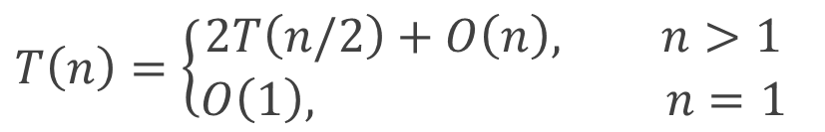
Analysis of Merge Sort
Let T(n) denote the worst-case running time of MergeSort where n is the number of items to be sorted
Assume that n is a power of 2.
Recurrence equation:
Divide: O(1) time
Conquer: 2T(n/2) time
Combine: O(n) time
$$T\left(n\right)=\left\{\begin{aligned}2T\left(n/2\right)+O\left(n\right), n>1 \\ O\left(1\right), n=1\end{aligned}\right.$$

Slide 21

Analysis of Merge Sort
Solve the recurrence relation $T\left(n\right)=O\left(n\log{n}\right)$
Note: this is also the best running time so in fact $T\left(n\right)=Θ\left(n\log{n}\right)$
T(n) = 2T(n/2) + n
= 2[2T(n/2²) + n/2] + n
= 2²T(n/2²) + 2n
= 2³T(n/2³) + 3n
= 2^{i}T(n/2^{i}) + i*n
Let i=log₂(n):
T(n) = nT(n/n) + n*log(n)
= O(n*log(n))

Slide 22
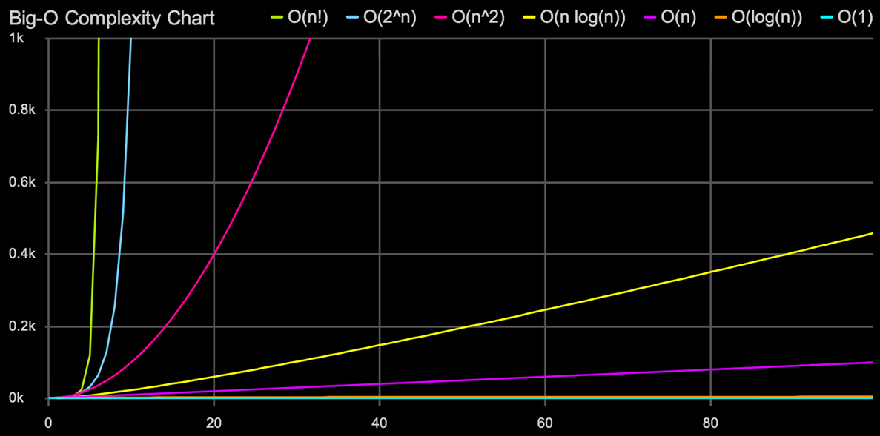
n*log(n) is much faster than n²!

Slide 23
Divide and Conquer
If the problem is large, break it into sub-problems that are smaller in size but are similar in structure to the original problem, recursively solve the sub-problems, and finally combine the sub-solutions into a final solution that solves the original problem.

Slide 24
Three Phases of DC
Divide: top → bottom
Divide a problem into sub-problems
Conquer: bottom level
Solve the sub-problems recursively
If the sub-problems are small enough, solve them as base cases
Combine: bottom → top
Combine the solutions to the sub-problems into that of the original problem
Usually the key!

Slide 25
Divide-Conquer-Combine
problem
divide
subproblem
subproblem
conquer
solve
problem
solve
problem
solution to
subproblem
solution to
subproblem
combine
solution to problem

Slide 26
Bigger Divide-Conquer-Combine
problem
divide
subproblem
subproblem
divide
divide
subproblem
subproblem
subproblem
subproblem
divide
divide
divide
divide
subproblem
subproblem
subproblem
subproblem
subproblem
subproblem
subproblem
subproblem
conquer
solve
problem
solve
problem
solve
problem
solve
problem
solve
problem
solve
problem
solve
problem
solve
problem
solution to
subproblem
solution to
subproblem
solution to
subproblem
solution to
subproblem
solution to
subproblem
solution to
subproblem
solution to
subproblem
solution to
subproblem
combine
combine
combine
combine
solution to subproblem
solution to subproblem
solution to subproblem
solution to subproblem
combine
combine
solution to
subproblem
solution to
subproblem
combine
solution to
problem

Slide 27
Task
Create a class, Sorting2, which includes at least four static methods
public static void insertionSort(int[] A)
Two overloading mergeSort methods
public static void mergeSort(int[] A)
private static void mergeSort(int[] A, int left, int right)
The first one is public and is for the user to call
The second one is private and recursive
The second one is called by the first one
public static void main(String[] args)
Auxiliary methods may be defined
Submit Sorting2.java to iSpace

Slide 28
Task
public static void insertionSort(int[] A)
A is an array of integers
Sort A using insertion sort
public static void mergeSort(int[] A)
It calls the recursive mergeSort method to sort A
mergeSort(A, 0, A.length-1)
private static void mergeSort(int[] A, int left, int right)
Sort sub-array A[left..right] using merge sort
public static void main(String[] args)
Generate an array A1 consisting of 10⁵ random integers which are in range [0, 999]
Generate another array A2 which is identical to A1
Sort A1 using insertionSort and A2 using mergeSort
Print the elapsed time in milliseconds during which both search functions run, respectively

